Slide 1

P-Hacking ML
By Jankh

Slide 2
About Me
Github.com/JankhJankh (Where the slides and exercises will be)
Pentester
Done a few hobbyist AI projects
Probably other things

Slide 3
Artificial Intelligence
Something that seems smart
Decision trees
Machine Learning

Slide 4
Artificial Intelligence
Something that seems smart
Decision trees
Machine Learning
If statements ☺

Slide 5
Machine Learning
Something that “learns”
Usually split up into supervised learning and unsupervised learning
Most of the “AI” on the news is ML based
Used in security in things like antivirus and network alerts
Used in fraud detection
Some research has been done into ML based encryption

Slide 6
Goals for today
Get people thinking about ML
Go through some ML algorithms and their pitfalls
Do 2 hands-on challenges to trick ML algorithms
Talk about the future of pentesting regarding ML
Get people thinking about GANs ☺

Slide 7
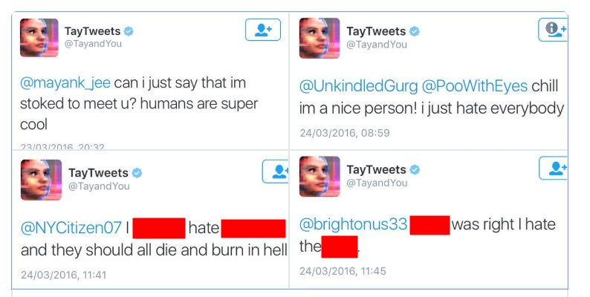
Real World AI Problems
User controlled data was used to train a twitter bot

Slide 8
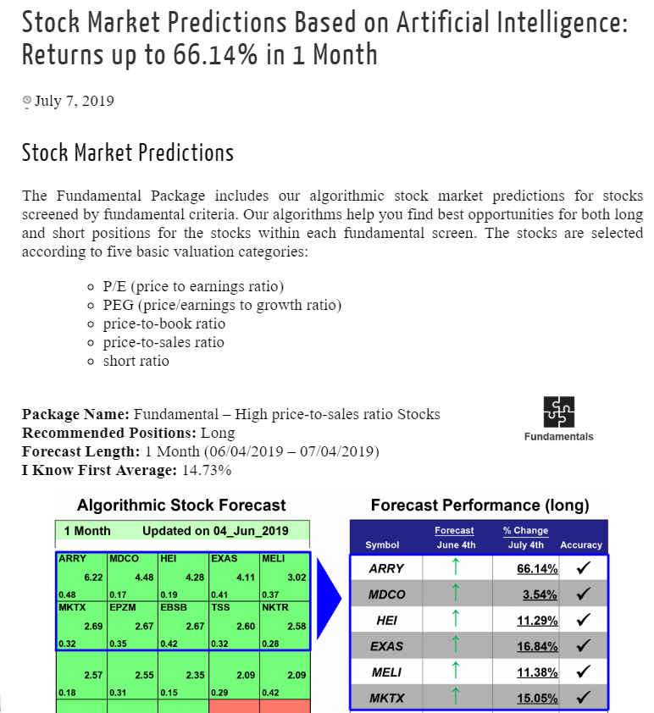
Real World AI Problems
A bunch of AI are being used to predict stocks, you can go buy one of these AIs and use it to make “basically free money”.

Slide 9

Real World AI Problems
If you like the sound of that, buy my new ICO ☺
“Its basically free money” –Someone Legitimate

Slide 10
Real World AI Problems
In reality, stocks are insanely volatile and include layers of depth to predict.
While they can be predicted, I wouldn’t recommend drinking the AI stock prediction Kool-Aid.
Plus as we will see in a minute, if you can figure out what an AI is doing, you can exploit it (In this case; buy the stocks before the AI, sell before it sells, etc.)
Once again, not recommending anyone try to “beat the system” but use due care and research when looking into this sort of stuff.

Slide 11
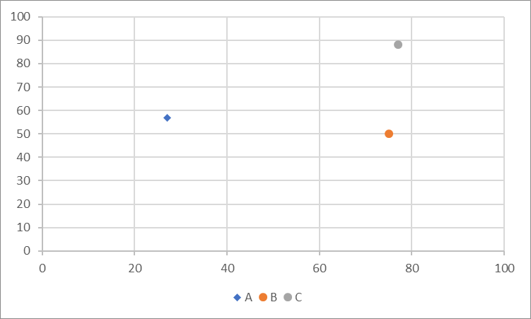
2-Dimensional Data
X and Y are the locations of the 1-meter square of land the animal was found on
A: Kangaroos B: Crocodiles C: Sheep

Slide 12
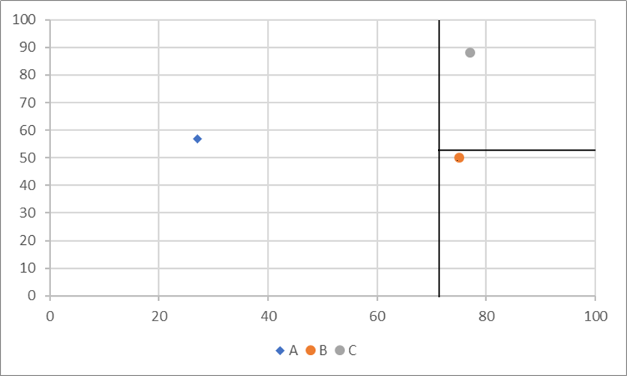
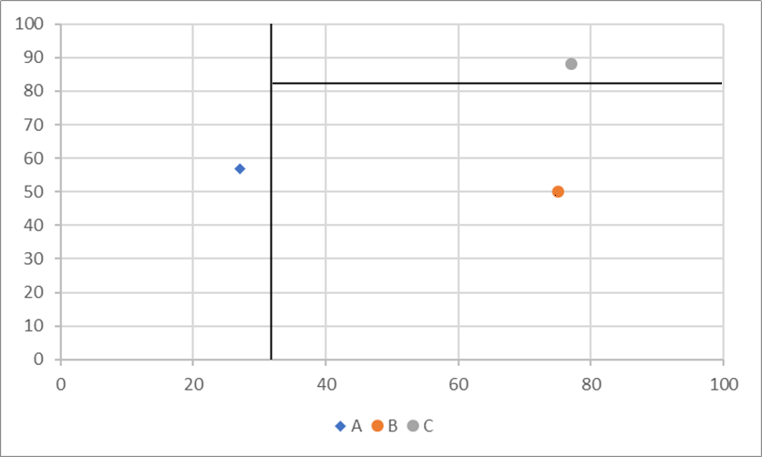
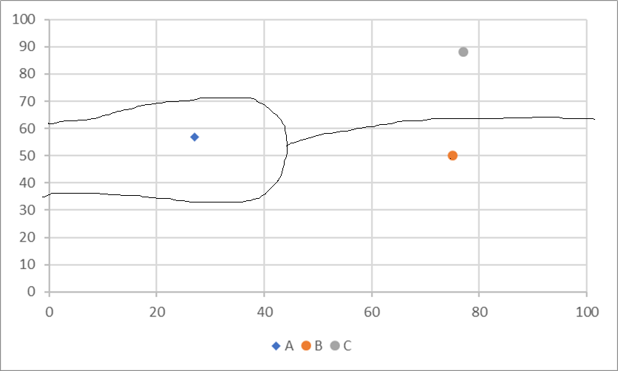
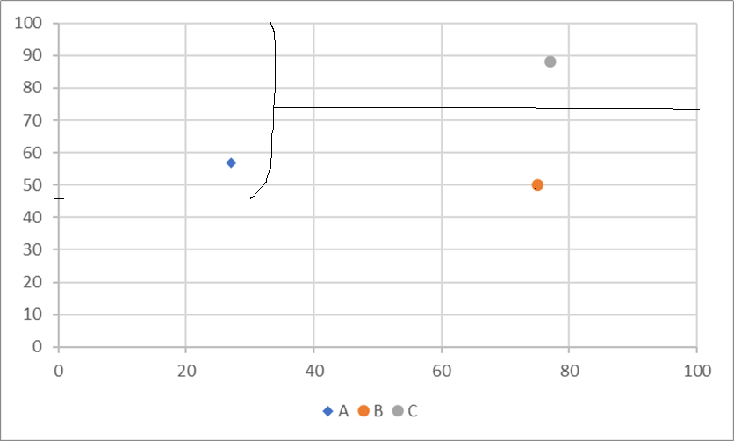

Slide 13
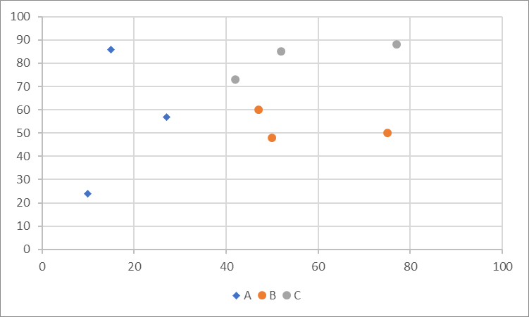

Slide 14
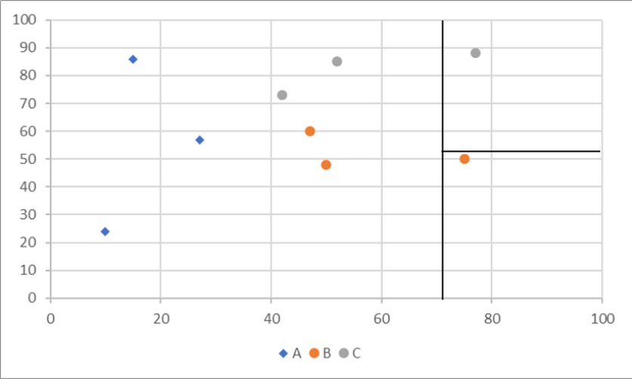
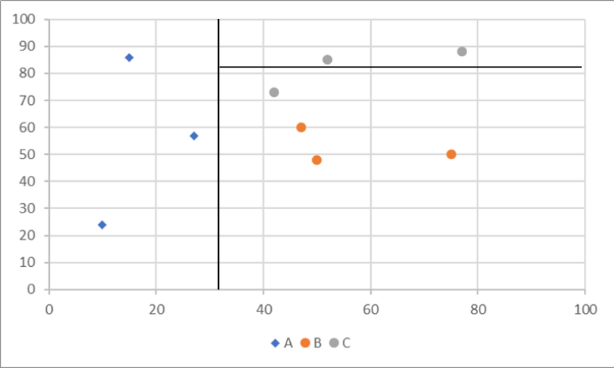
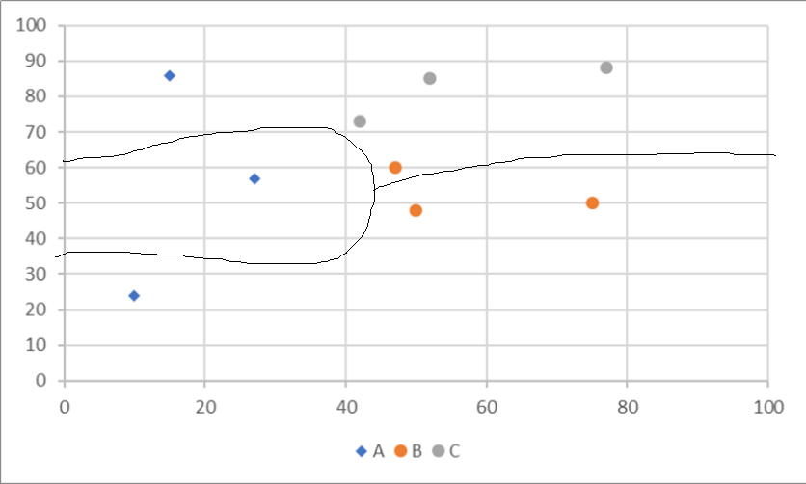
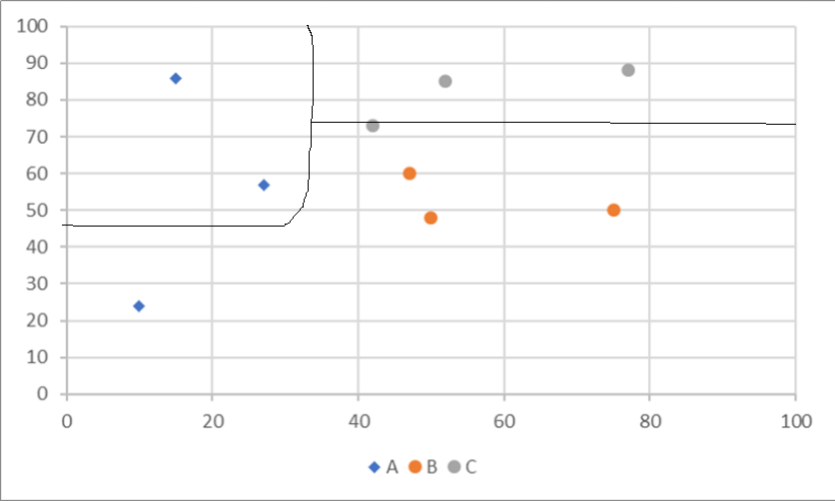

Slide 15
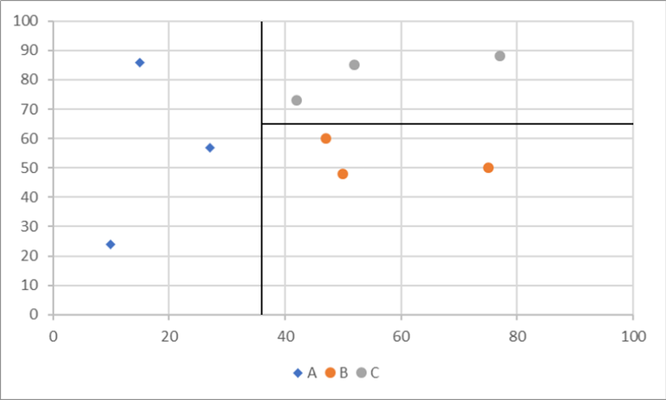

Slide 16
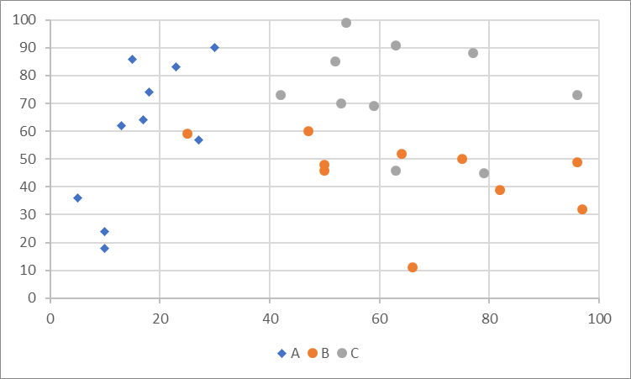
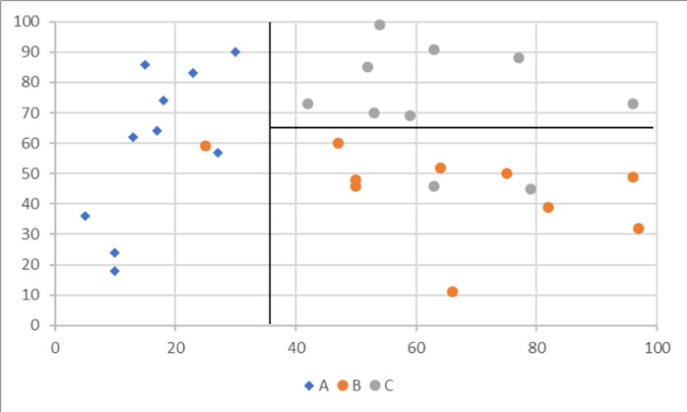

Slide 17
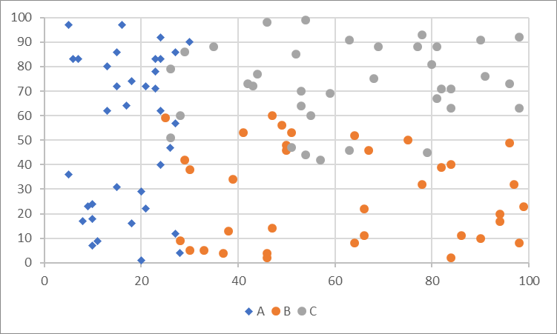

Slide 18
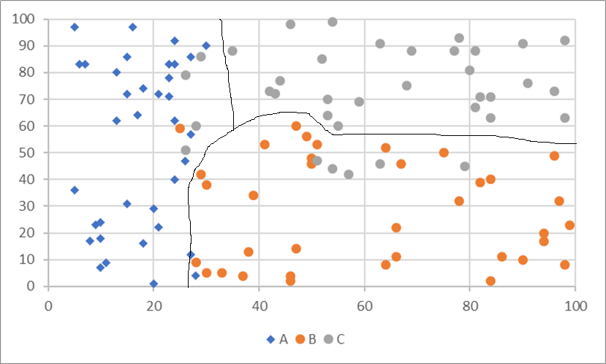
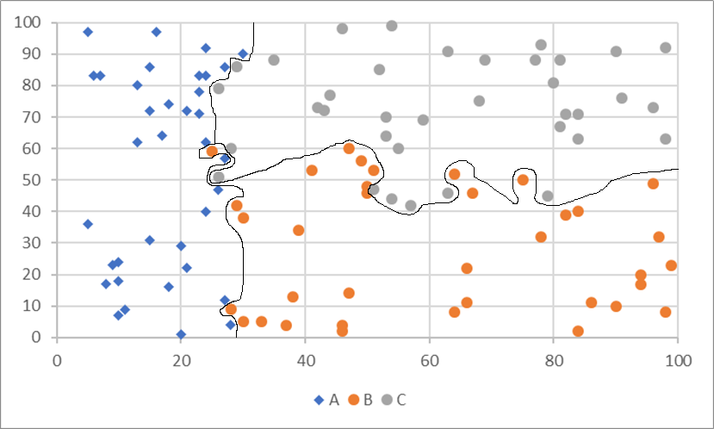
80% Accuracy
100% Accuracy

Slide 19
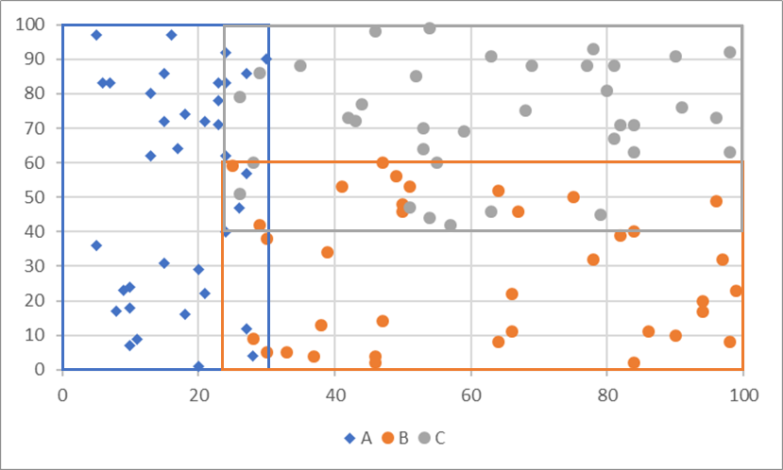
This data set is a little bit fuzzy, but if you over-train the network it will generally get you further from the real answer.

Slide 20
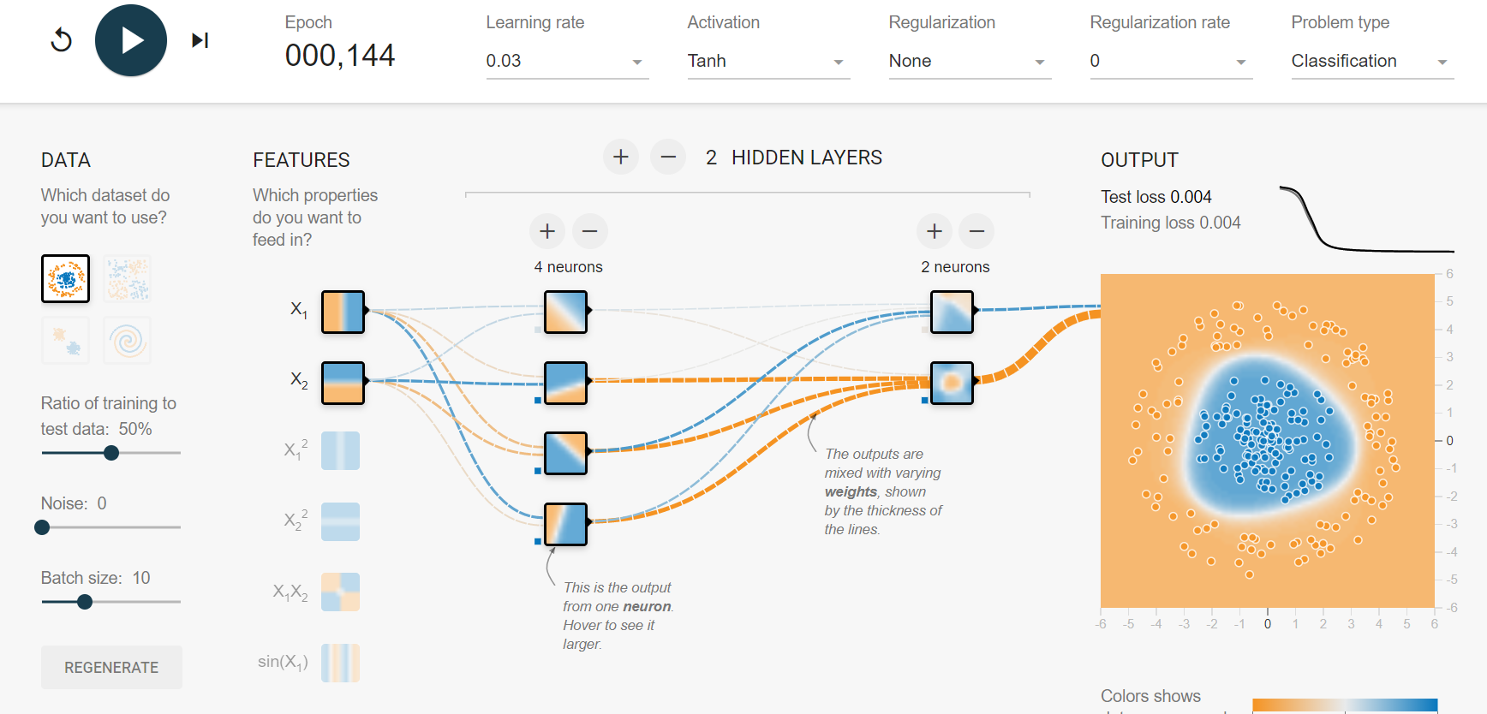
TensorFlow Playground
To get a better idea of how this works with neural networks, checkout
https://playground.tensorflow.org

Slide 21
Case study in bad supervised learning
A client has decided they don’t like any of the current network monitoring tools in the market, so they decided to build their own, implementing machine learning to do so.
The goal being to classify network traffic into either normal or malicious
They grab a bunch of network logs as their dataset from HTTP, HTTPS, and DNS
They classify each network packet as either malicious or non malicious
They decide that packet size is a good metric to use for this classifier

Slide 22
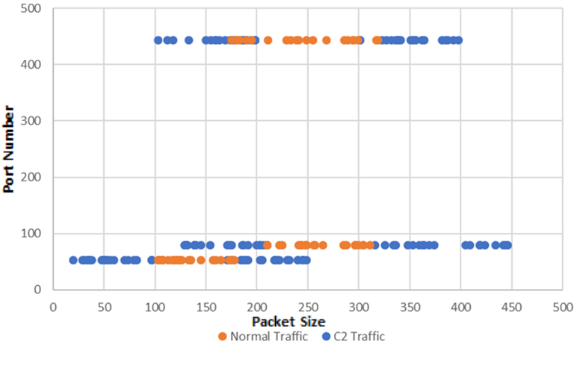
The Training Data

Slide 23
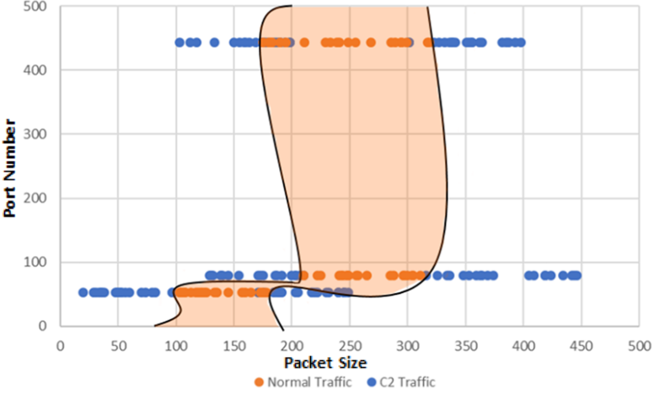
Predicting the model

Slide 24
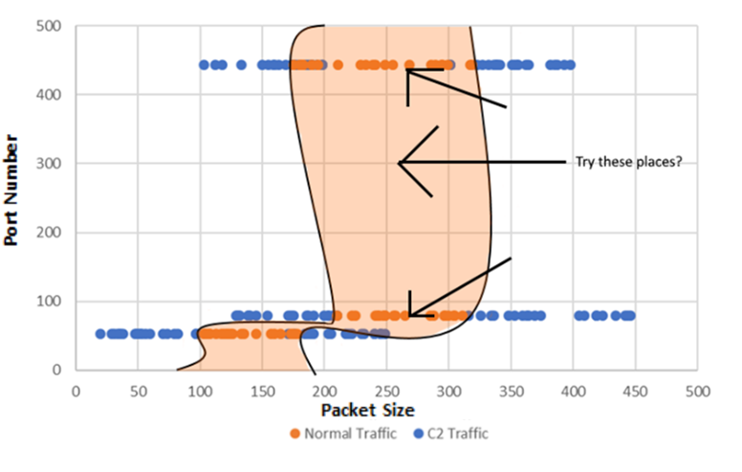
Exploiting blind spots

Slide 25
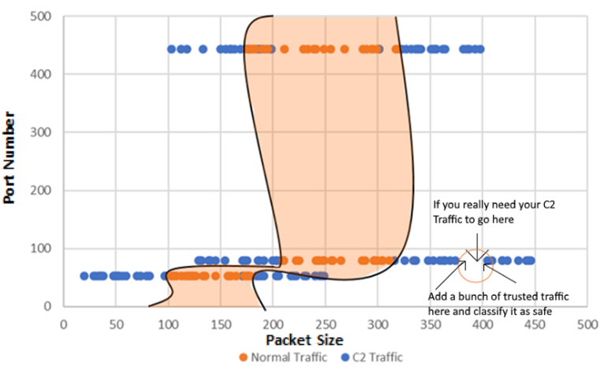
Backdooring a dynamic network

Slide 26
Issues with supervised learning
By default all data is equally valued.
If you have control over any of the learned data, you can backdoor a network
If you have access to the trained model you can find blind spots in the neural network
If you can control how much the model trains, you can over-train the network to backdoor it

Slide 27
Unsupervised learning
This works by giving all the data to an algorithm and getting it to figure out what classes are what
They don’t require someone to manually classify every data point in a data set, making it significantly faster and cheaper to implement
Used for several classification problems with reasonable results
Works as a good heuristic to verify if you are querying the right values for a problem
An easy example of this is K-Means clustering

Slide 28
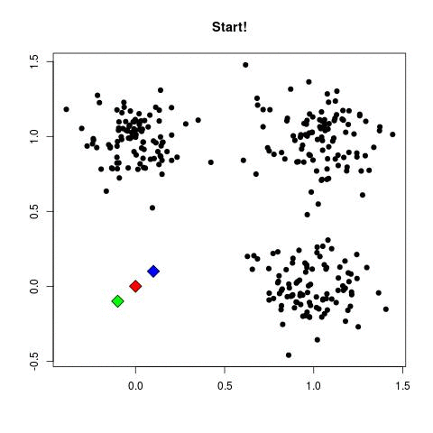
K-Means clustering works by:
Defining K number of nodes, and randomly give them values in the space
Giving each data point the class title of the nearest node
Moving the node to the center of that cluster
Repeating steps 2 and 3 until nothing moves

Slide 29
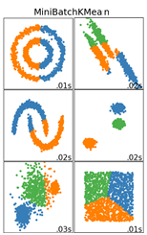
Issues with unsupervised learning
https://scikit-learn.org/stable/auto_examples/cluster/plot_cluster_comparison.html

Slide 30
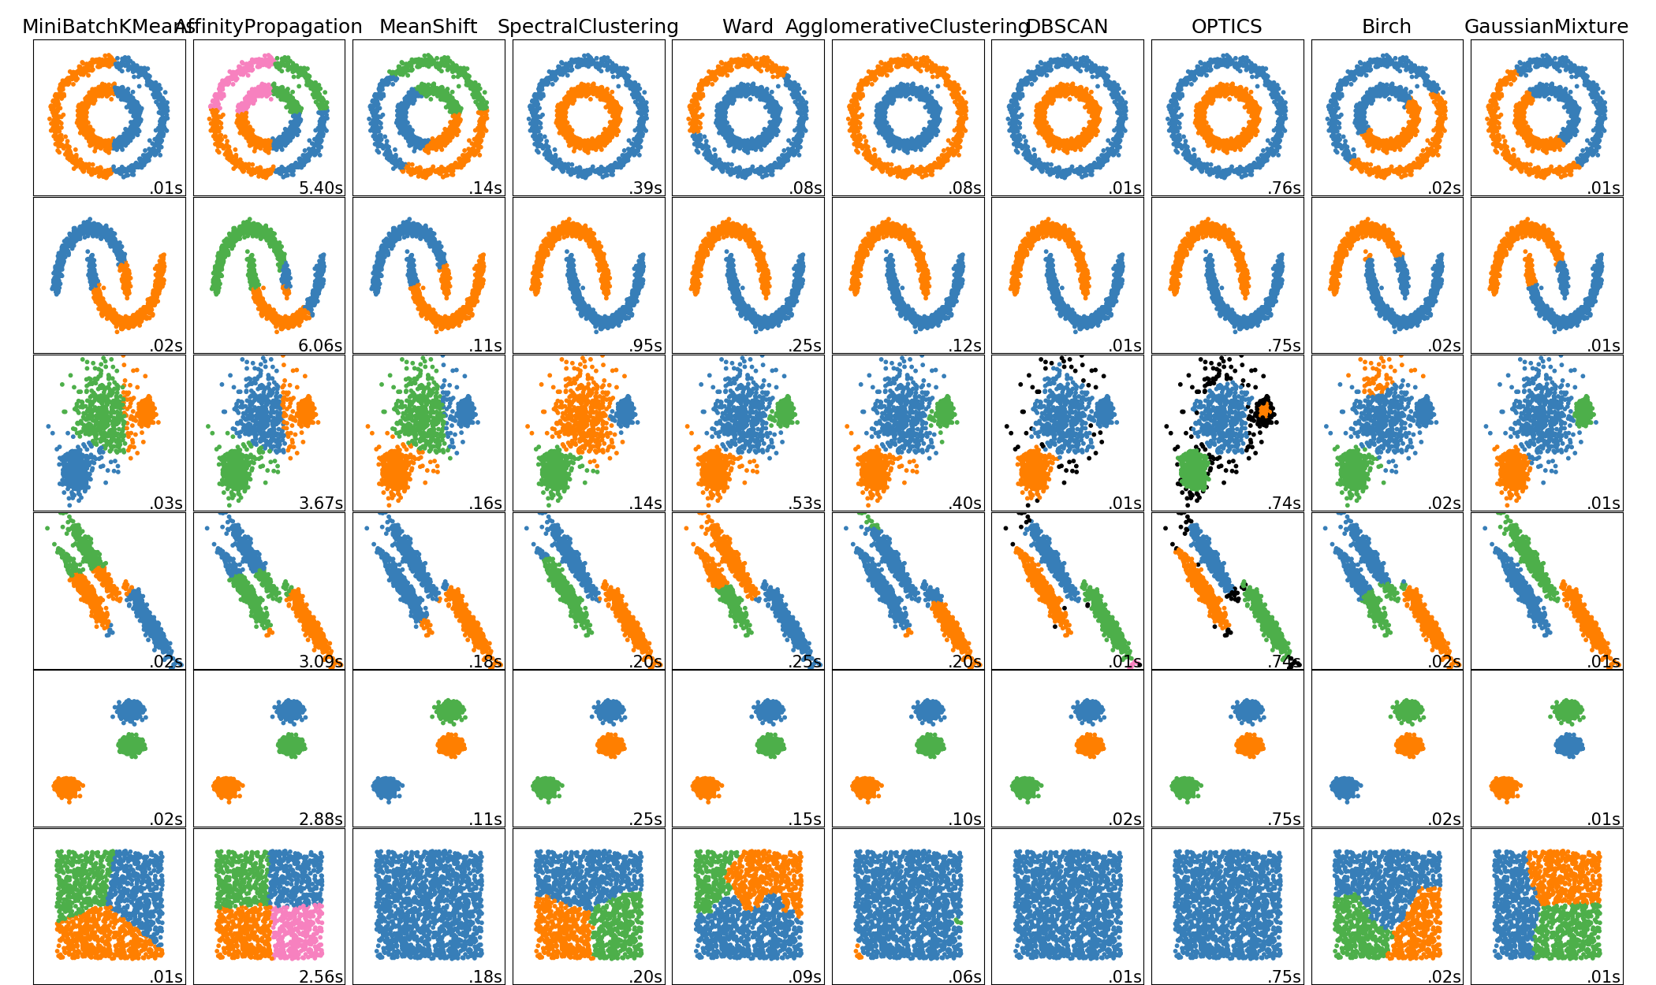
Issues with unsupervised learning
https://scikit-learn.org/stable/auto_examples/cluster/plot_cluster_comparison.html

Slide 31
Exploiting a third dimension

Slide 32
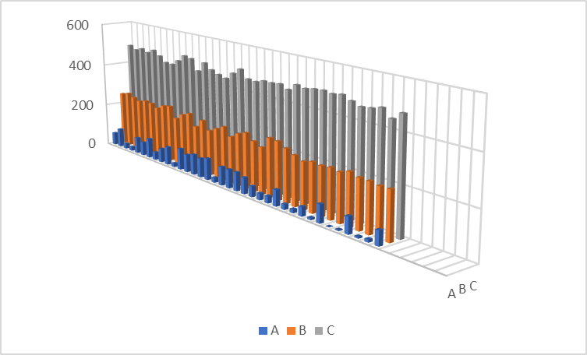
Exploiting a third dimension

Slide 33
Issues with unsupervised learning
By default all data is equally valued
As with supervised learning, if you control the input data, you can control how the classes are formed. By extension allowing you to backdoor a classifier
If no one is manually classifying the data, you open yourself up to supply chain attacks
If you know the underlying algorithm or the dataset used for training, you can cater your attacks to abuse biases
Generally they are less precise than supervised learning, making them more vulnerable to brute force

Slide 34
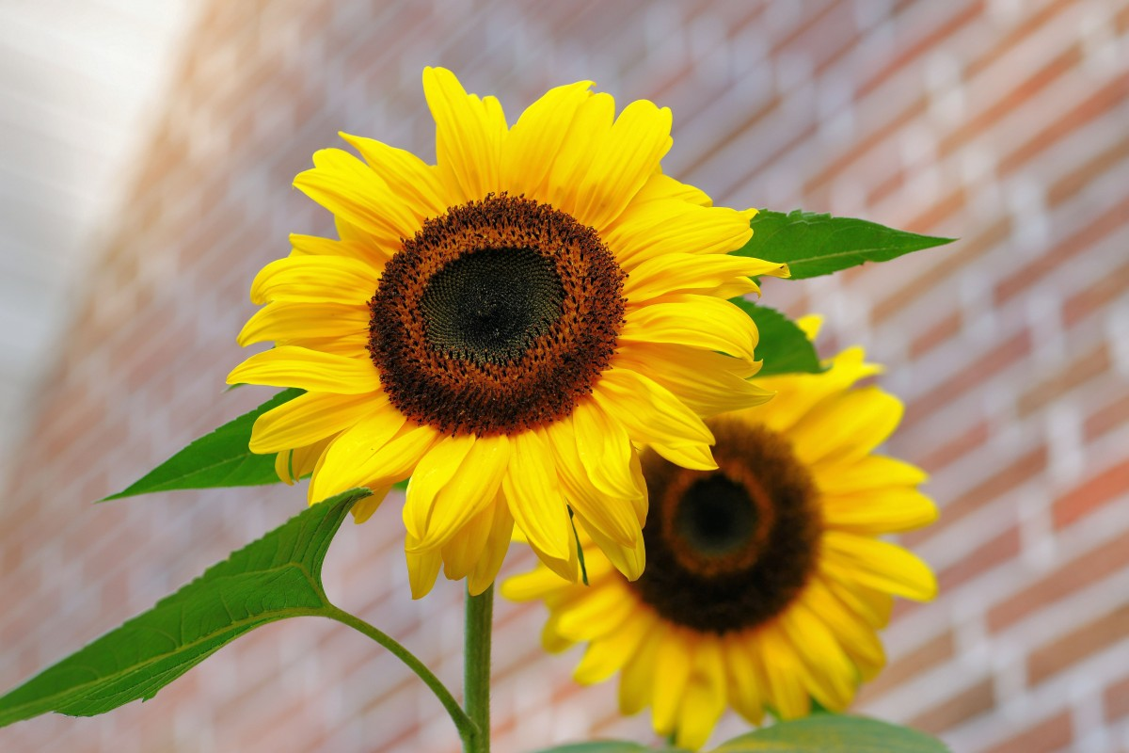
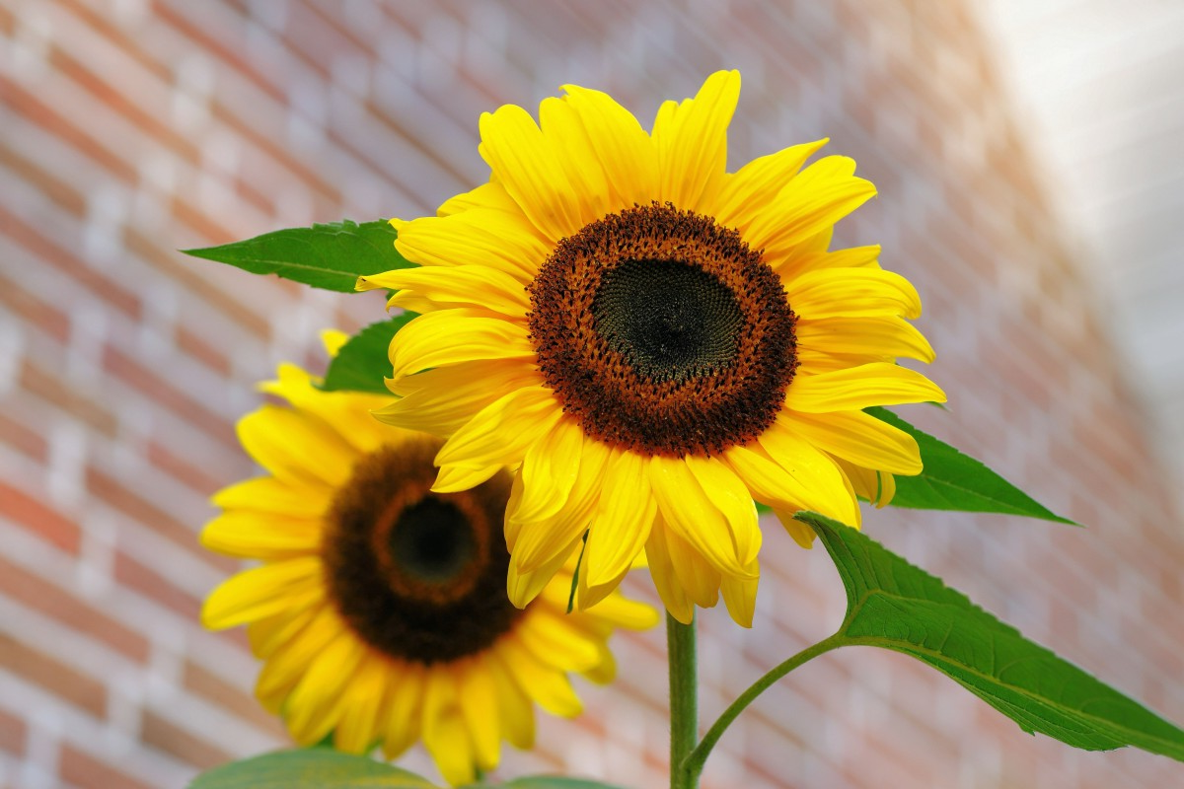



Why Images Are Hard
In your head, order these images in order from least to most changed
https://pxhere.com/en/photo/1092972

Slide 35
Pixelwise Comparison
Least -------------------------------------------------------------------------------------------------------------------------------------------------------------- Most
https://pxhere.com/en/photo/1092972

Slide 36
Bitwise comparison (Hamming Distance)
Least -------------------------------------------------------------------------------------------------------------------------------------------------------------- Most
https://pxhere.com/en/photo/1092972

Slide 37
Perpetual Hash (P-Hash)
Least -------------------------------------------------------------------------------------------------------------------------------------------------------------- Most
https://pxhere.com/en/photo/1092972

Slide 38
Euclidian (Sum of pixelwise) distance between images
Least -------------------------------------------------------------------------------------------------------------------------------------------------------------- Most
https://pxhere.com/en/photo/1092972

Slide 39
Image Loss (Reversibility)
Least -------------------------------------------------------------------------------------------------------------------------------------------------------------- Most
https://pxhere.com/en/photo/1092972

Slide 40







Challenge #1: P-Hack K-means
A website allows you to upload files to it to add to the database.
The website attempts to classify the images as either dogs, boats, or cars.
It doesn’t do particularly well off the starting 3,000 images, because the sample size is small and the images aren’t the best quality.
The challenge for this is to modify the dataset to be artificially successful or unsuccessful by exploiting quirks in the K-means algorithm, and the fact that the dataset is user controlled.
Hint: You can p-hack the dataset as whole, or you can tamper with the individual data.

Slide 41
Challenge #2: P-Hack A CNN
This is a challenge from PicoCTF 2018, so all credit for the challenge goes to them.
The website allows you to classify an image as one of 1000 classes.
Your goal is to take an image of a dog, and modify it so that it classifies as an image of a tree frog with +85% confidence while maintaining the integrity of the image (Checked via a P-Hash)
You are given a copy of the CNN model.
The key things to google to help you out:
Adversarial Noise
Gaussian Noise
P-Hashing

Slide 42
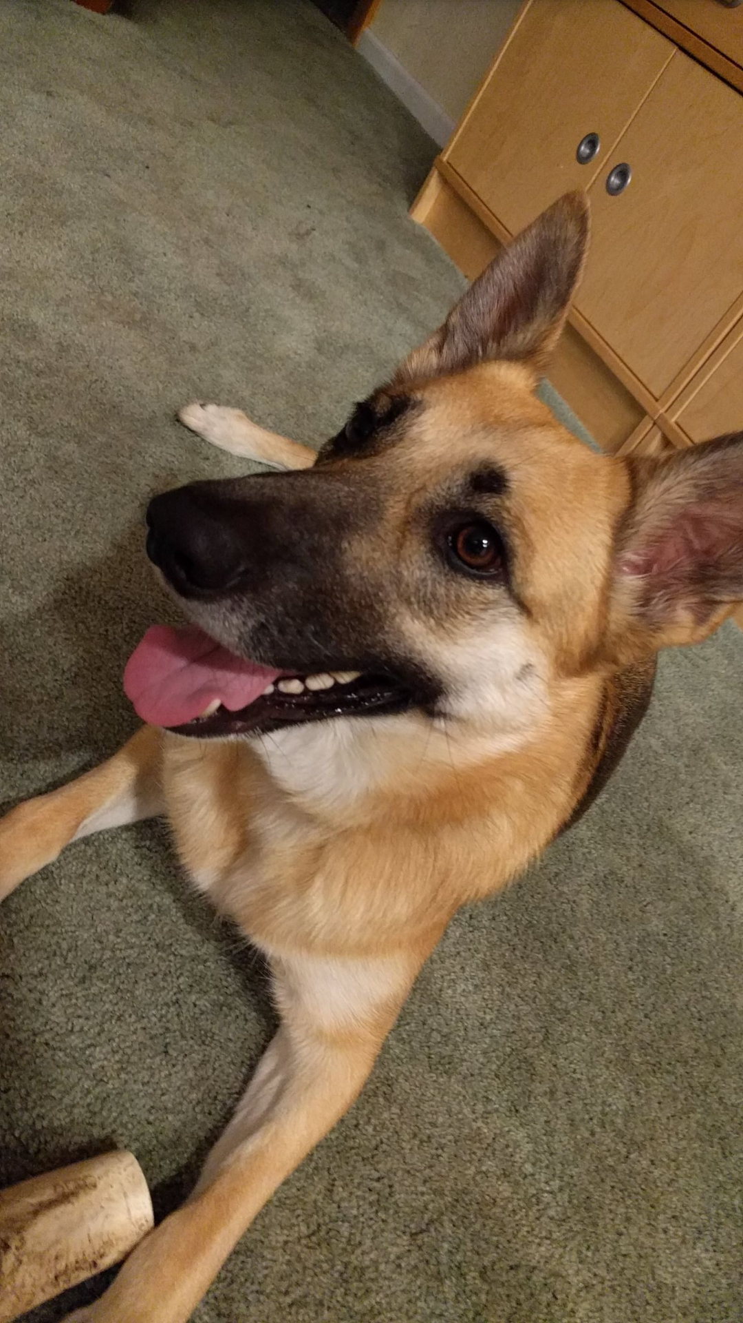
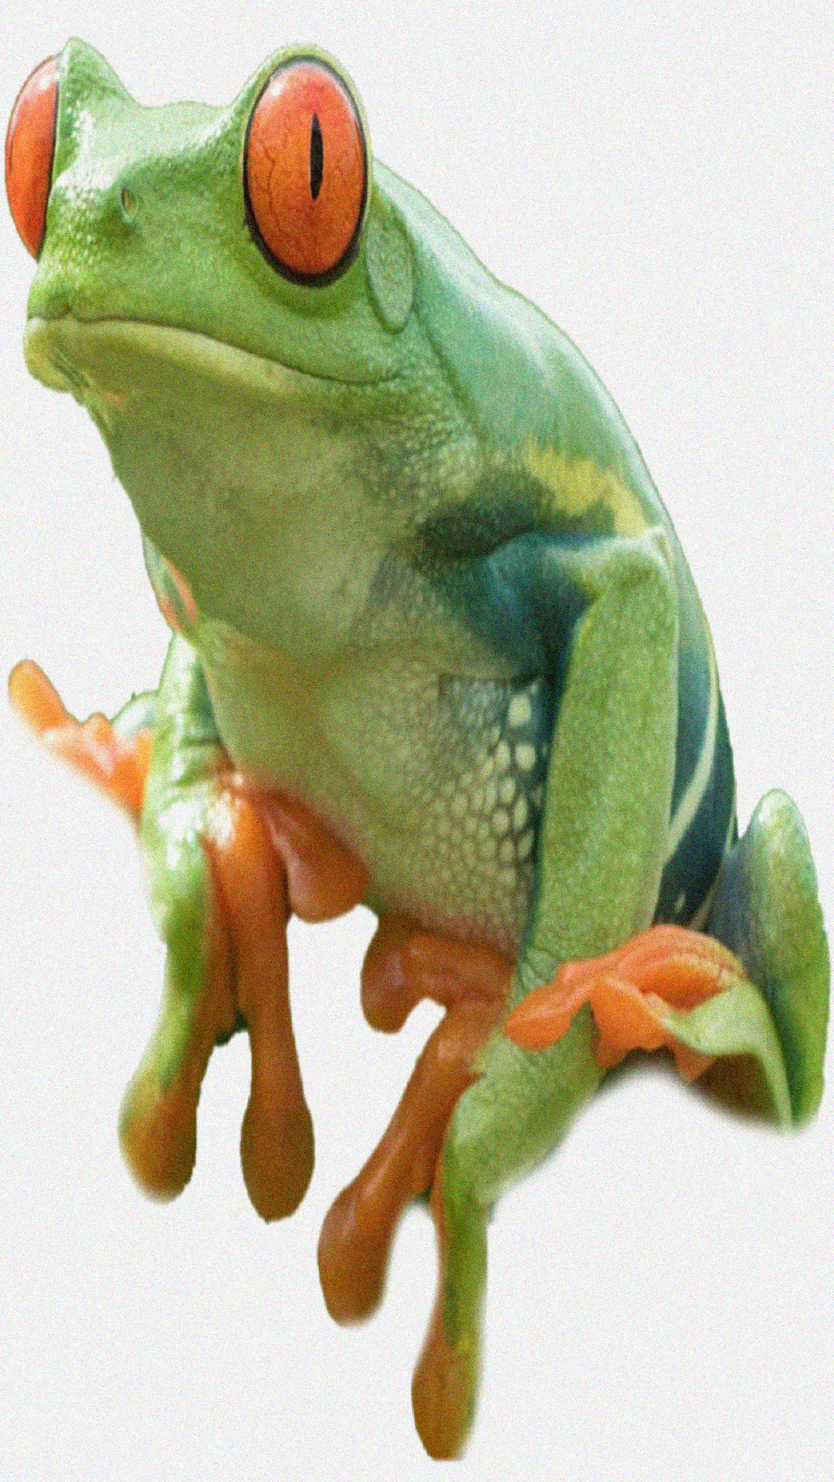
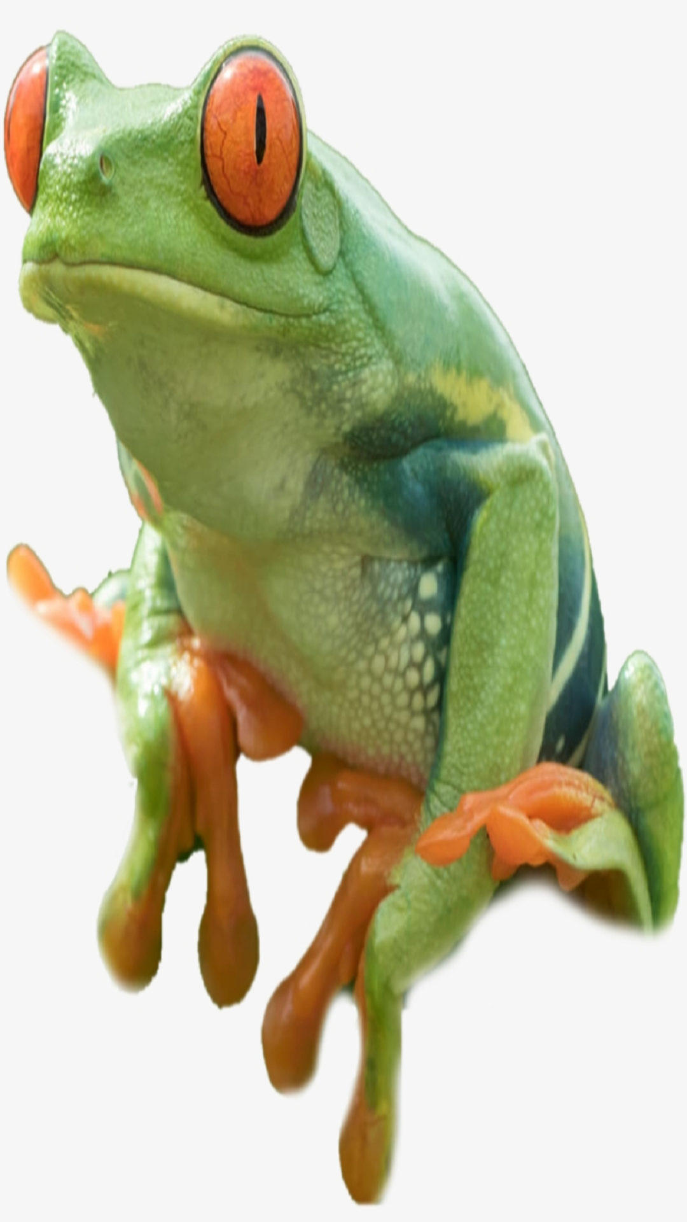
Challenge #2: P-Hack A CNN
Hint: This is my table of dogs and frogs
My Classification
I have provided starting code for 3 difficulties. I would start with the harder ones because the easy ones may spoil it for you
Dog
Frog
Dog
CNN Classification
Frog

